Slide 1
Oracle certified Java associate
Lesson 9
Andrei Dragutan

Slide 2
2 părți
Java classes objects and methods
Întrebări - răspunsuri

Slide 3
OOP

Slide 4

The class - blueprint of the created objects
It represents the set of properties or methods that are common to all objects of one type.
Class declaration include:
access modifiers - public/private/default
class name
ancestors (if any)
body

Slide 5
The class - blueprint of the created objects
Encapsulation
Inheritance
Polymorphism
Abstractisation/Data Abstraction

Slide 6
The class (example)
public class Application {
}

Slide 7
The class ancestors (example)
public class Programmer extends Employee{
}

Slide 8
Object
Representation of the class -> real life entities
Every object is characterized by:
identity
state
behavior

Slide 9
Object - example
Real life entity -> Dog
A Dog is characterized by:
identity – unique java identifier
state – name, age, color, breed
behavior - bark, eat, sleep

Slide 10
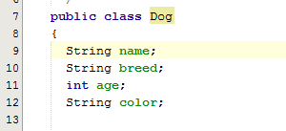
Object - state
It is represented by attributes of an object.
It also reflects the properties of an object.
The attributes of the object are defined in the class:

Slide 11
Object - behavior
It is represented by methods of an object.
It reflects the actions exposed by an object.
The methods of the object are defined in the class

Slide 12
Methods
Is a function, that execute a specific action
The declaration of the method consist of:
access modifiers - private/public/protected/default
return type
name
braces ()
parameters (if any)
body {}
A class can have multiple methods with the same name & return type but with different parameters

Slide 13
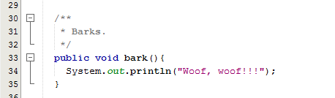
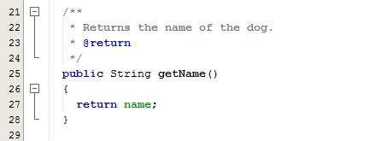
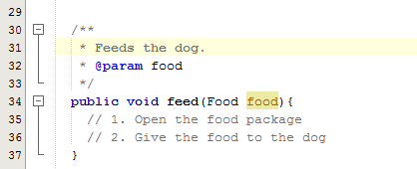
Method - example

Slide 14
Creating objects
Objects are created from classes
The procedure of creating the object is called instantiation
It uses the keyword new

Slide 15

Creating objects - example

Slide 16
Creating objects - the constructor
Special method of the class
has the name of the class
has no return type

Slide 17
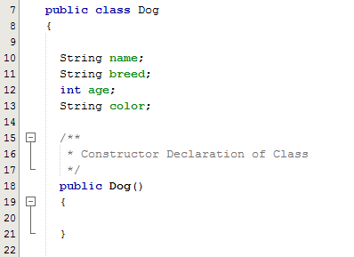
The constructor - example

Slide 18
Creating objects - the constructor
Every class has at least one constructor
The compiler will insert the default constructor into the .class file during the compilation if it’s missing from the class definition
Default - no parameters
A class can have multiple contructors
with different parameters

Slide 19
Why?
Initialize the state of the object during the instantiation

Slide 20
Working with objects
After instantiation we get a reference to an Object
Reference = variable of a custom type, instantiated

Slide 21
Dot operator ( . )
Access the fields of the object
Access the methods of the object

Slide 22
Întrebări, sugestii, propuneri

